Slide 1
Café Conundrum
Atomic
Notes:
AYDEN: Welcome slide. We are Atomic, and we would like to present our new game concept: Café Conundrum

Slide 2
A TOP-DOWN café simulator set in SOUTH AFRICA. Players deal with the CHALLENGES and DIFFICULTIES of managing a café, in addition to the CHAOS of loadshedding, service delays and many other unpredicted trials.
We want to make future small business owners aware of the effects poor service delivery has on them.
Notes:
Café Conundrum is: …
We want to influence: …

Slide 3
CORE Concept
Casual, Management Game with elements of WAVE SURVIVAL and STRATEGY.
Played in third-person with a top-down fixed camera. (3/4 perspective)
Manage café by SERVING and CLEANING AFTER customers.
In addition, daily INTERUPTIONS will provide an additional challenge as the days pass.
Customers will have a satisfaction and patience meter, which determines their overall experience.
Every day the game will increase in difficulty by adding more INTERUPTIONS and adjusting the customer patience.
After successful service, customers will award players with currency and after a successful day, players will receive XP.
Currency and XP is needed to be used to purchase and upgrade items, for easier workflow.
Each day will be considered a level. Players must “survive” for as many days as possible, with each day becoming harder.
Players will have to maintain a REPUTATION meter. If the meter reaches zero, the game ends.
Notes:
The Core Concept

Slide 4
Challenges/INTERUPTIONS
Loadshedding
Lack of Clean Water
Sewerage Problems
Notified at the beginning of day.
Kitchen stops working.
Players must pre-order food, enough to satisfy customers.
Notified at the beginning of day.
Affects customer rating.
Must boil water before use.
Notified during level.
Decreases patience level and can cause customers to walk out spontaneously.
Must pay for own plumber. (Using company telephone)
Road Maintenance
Crime
Refuse removal
Poor roads will result in less customers arriving to location (meaning less earnings).
Players can temporarily fix it, will need to do this daily.
Happens when payment is left on table.
Players will not receive that payment if criminal gets away.
Players can hire security (Daily Expense).
Bad Smell causes less patience in customers.
Less payment/tips from customer.
Players call for private collection or remove the garbage themselves.
Notes:
Some of the challenges you may face throughout the game:

Slide 5
Upgrades/Purchases
All upgrades can be purchased with the currency when required XP level is reached. Examples of upgrades include:
UPGRADED SHOES: These provide the player with an increased movement speed.
PROFESSIONAL CHEF: Meals are prepared faster.
UPGRADED BARISTA MACHINE: All Hot Drinks can be prepared faster (*More types of drinks?)
UPGRADED SODA MACHINE: All cold drinks can be prepared faster (*More types of drinks?)
GENERATOR Allows limited number of food items to be made when loadshedding is happening.
Water Dispenser Limited access to clean, fresh water. Useful during times where there is not clean water. Used to make drinks (also limited).
Notes:
At certain points in the game the player can purchase upgrades with their currency.

Slide 6
Upgrades/Purchases
HIRE BODYGUARD: Protect café from thieves, paid daily.
SEWERAGE FIX: If there is problems with sewerage, you can hire a plumber.
ROAD MAINTENANCE: Hire private company to fix roads leading to café.
REFUSE REMOVAL Pay for your refuse to be removed, if the government does not do it.

Slide 7
A small look into the setting and Story
Notes:
KAT:
We shall now have a look in the setting and story of the game.

Slide 8
SETTING
The game takes place in modern day South Africa (2024) in central Johannesburg.
STORY
You play as a small business owner, having inherited your uncle’s barely functioning restaurant after his untimely passing.
You decide to continue this restaurant out of love and respect for your uncle, not fully aware of how difficult such a task will be.
To help you get started with learning the mechanics of the game, your friend Thabo gives you advice about the ins and outs of a restaurant. He also sources your initial clientele to generate traffic towards your restaurant.
As you progress through the game, you will come to understand how poor government service delivery affects the success of your restaurant and must learn to overcome it. For the rest of the game, you will build the reputation of the restaurant and make it the success your uncle had always dreamed it to be.

Slide 9
CONCEPT ART
Character Design
Texturing/Style
Level Props/Design
UI
Notes:
CORBIN:
We will now have a look at the first iteration of the concept art for the game.

Slide 10
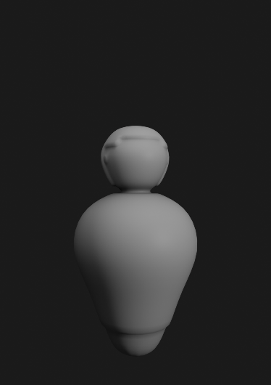
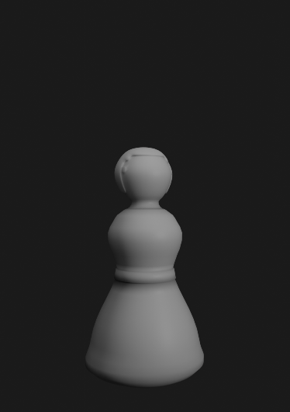
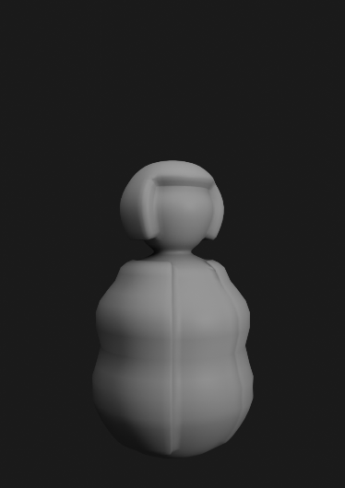
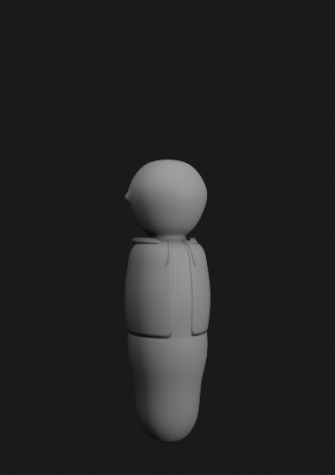
Character Design
We want to represent a DIVERSE range of characters that will accurately represent the DIVERSITY OF SOUTH AFRICANS.
Step 1: Body Types
We want to represent different people through their body types.
Notes:
Represent a DIVERSE range of characters. First layer: Body Types

Slide 11

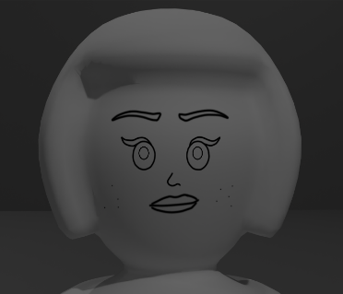
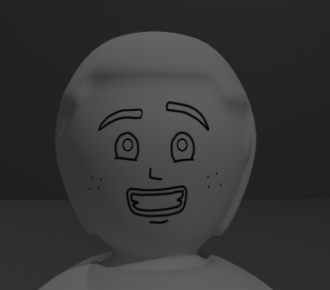
Character Design
Step 2: Expressions
We want to represent a large range of facial features and expressions, with a texture-replace art style.
Notes:
Second Layer: Through facial features and expressions

Slide 12
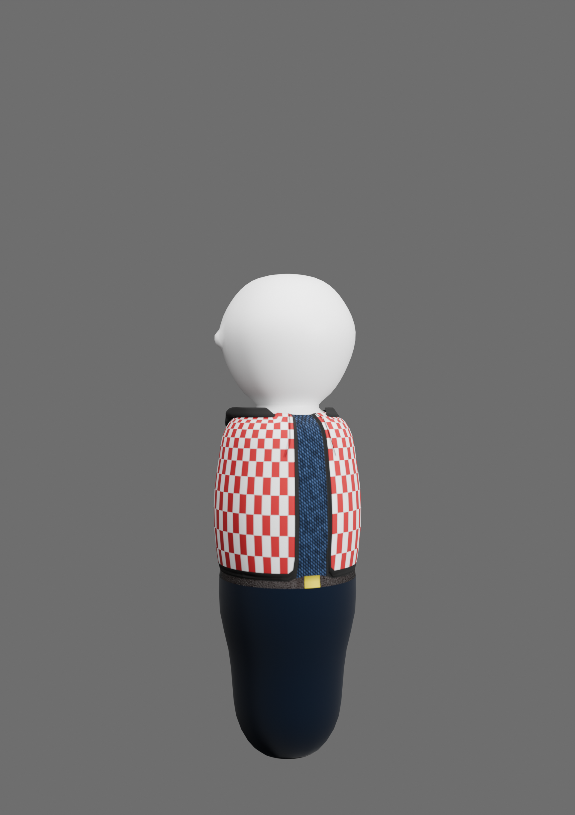
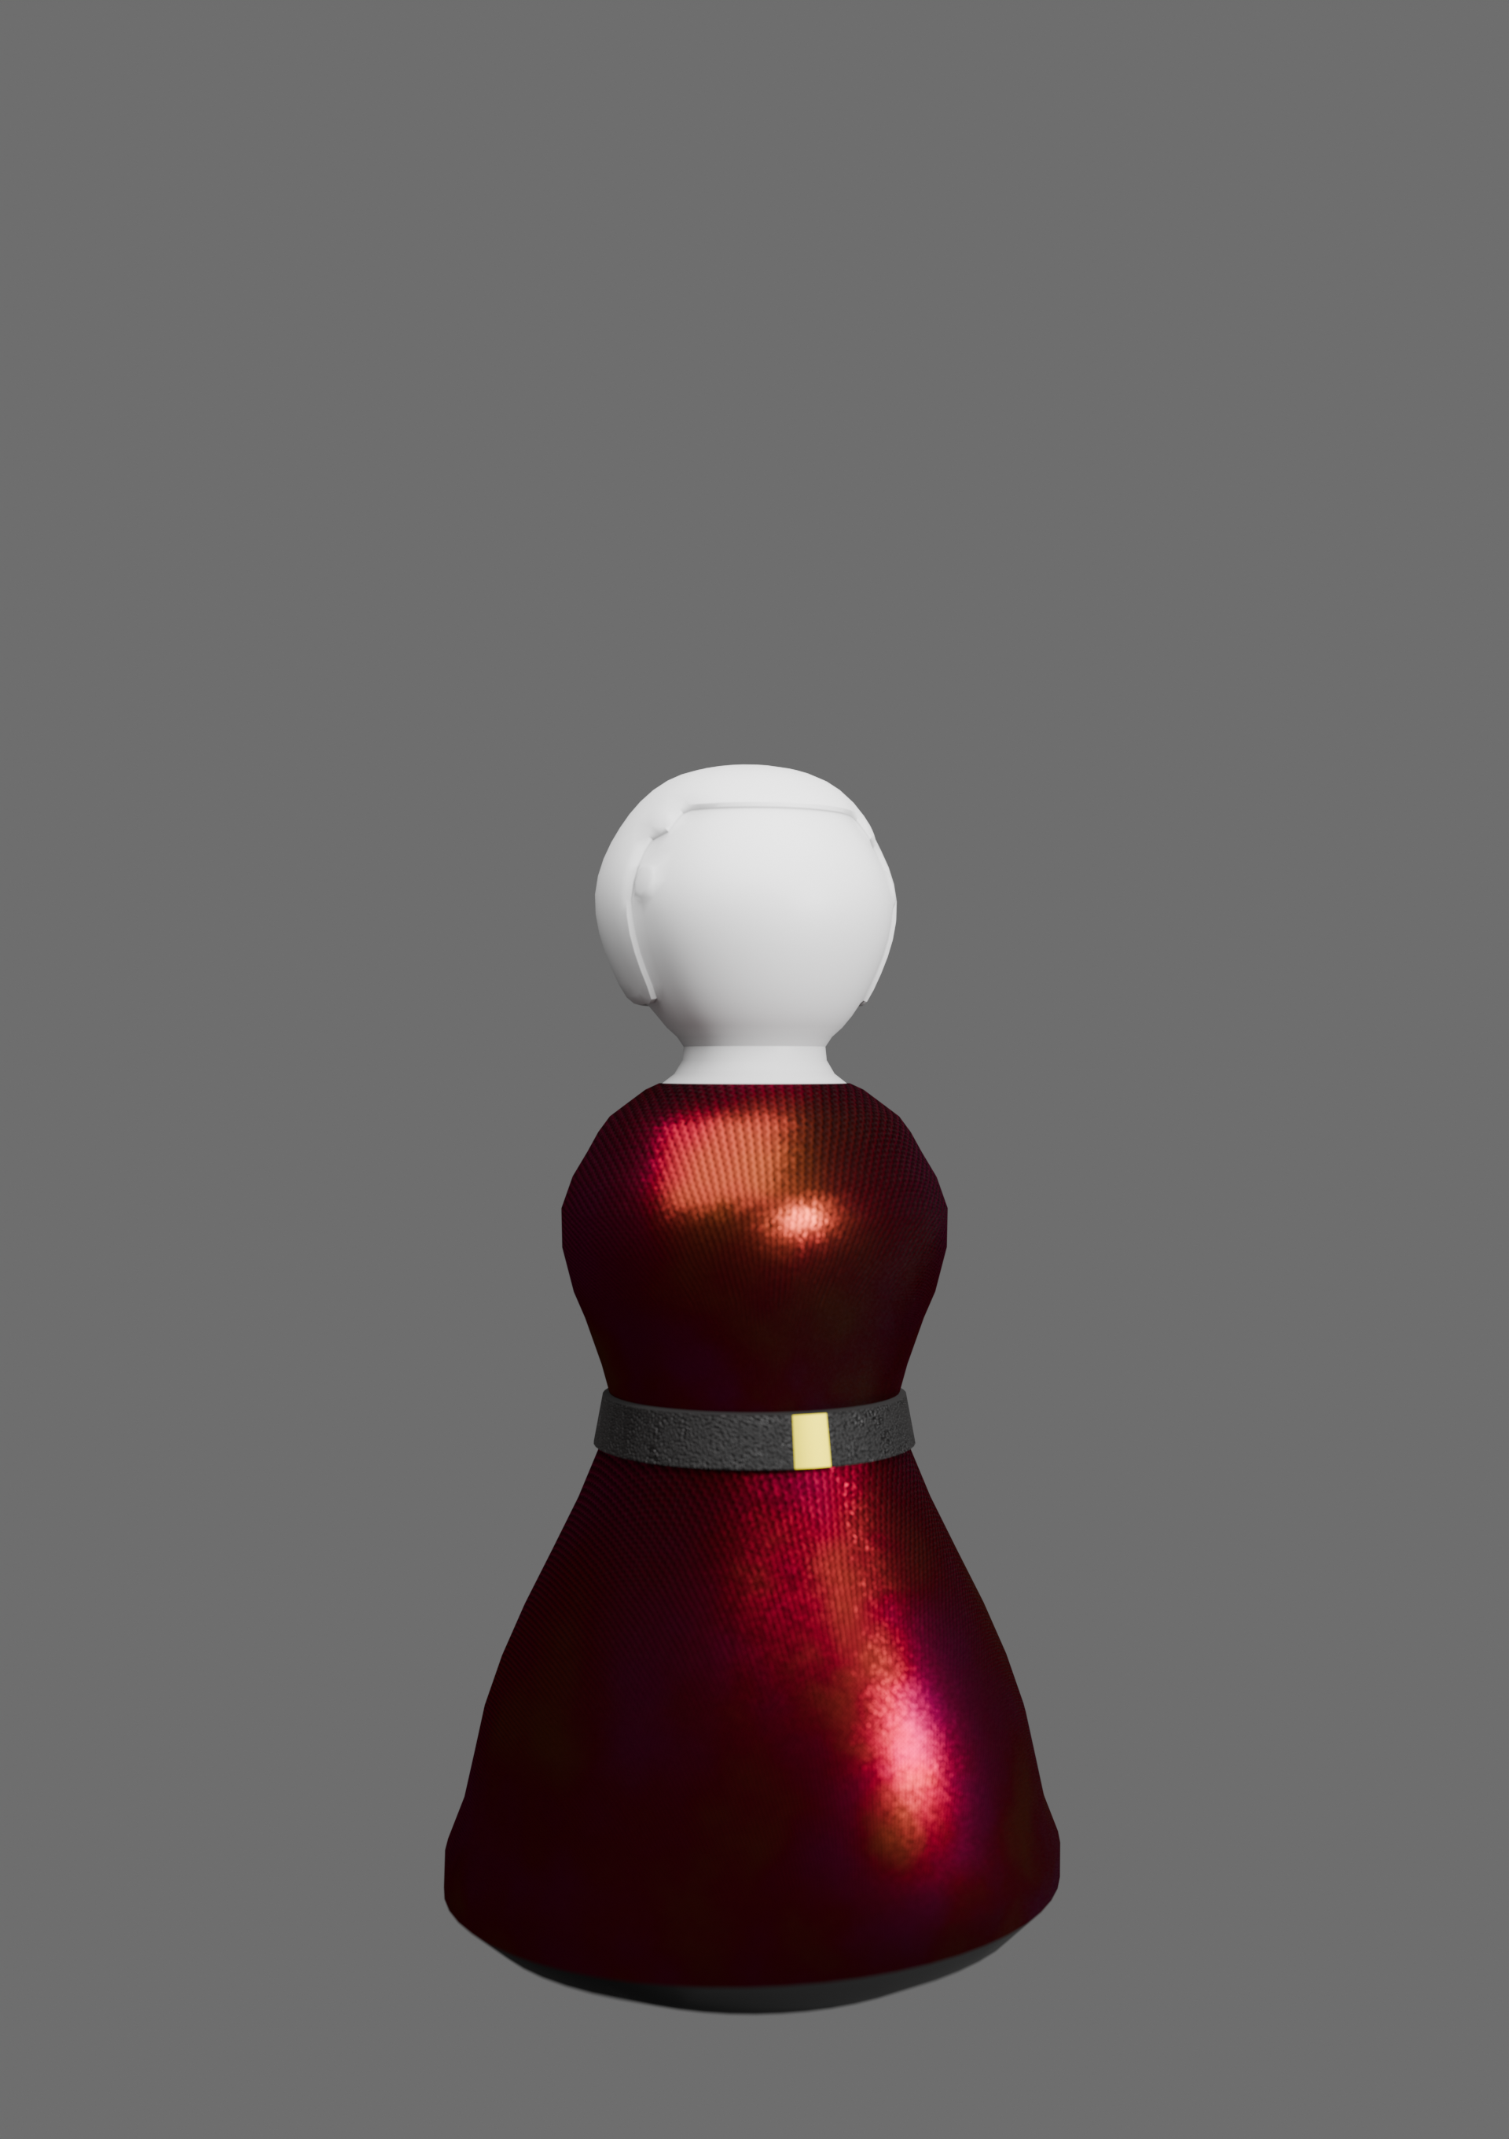

Character Design
Step 3: Clothing
Finally, we want to show the UNIQUE STYLES present in South African culture, through a MODULAR CLOTHING SYSTEM.
Notes:
Third Layer: Through Different clothing types

Slide 13
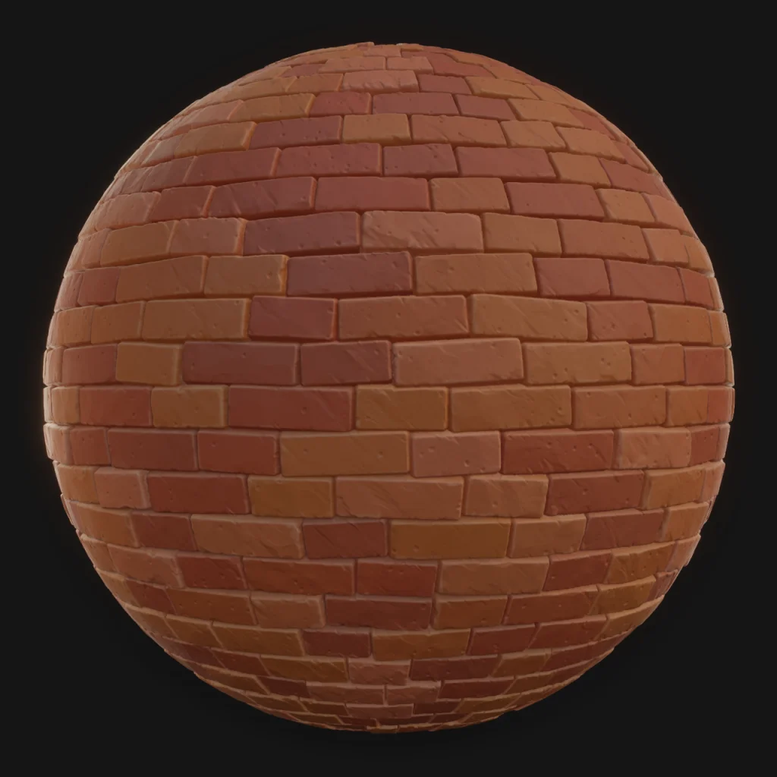

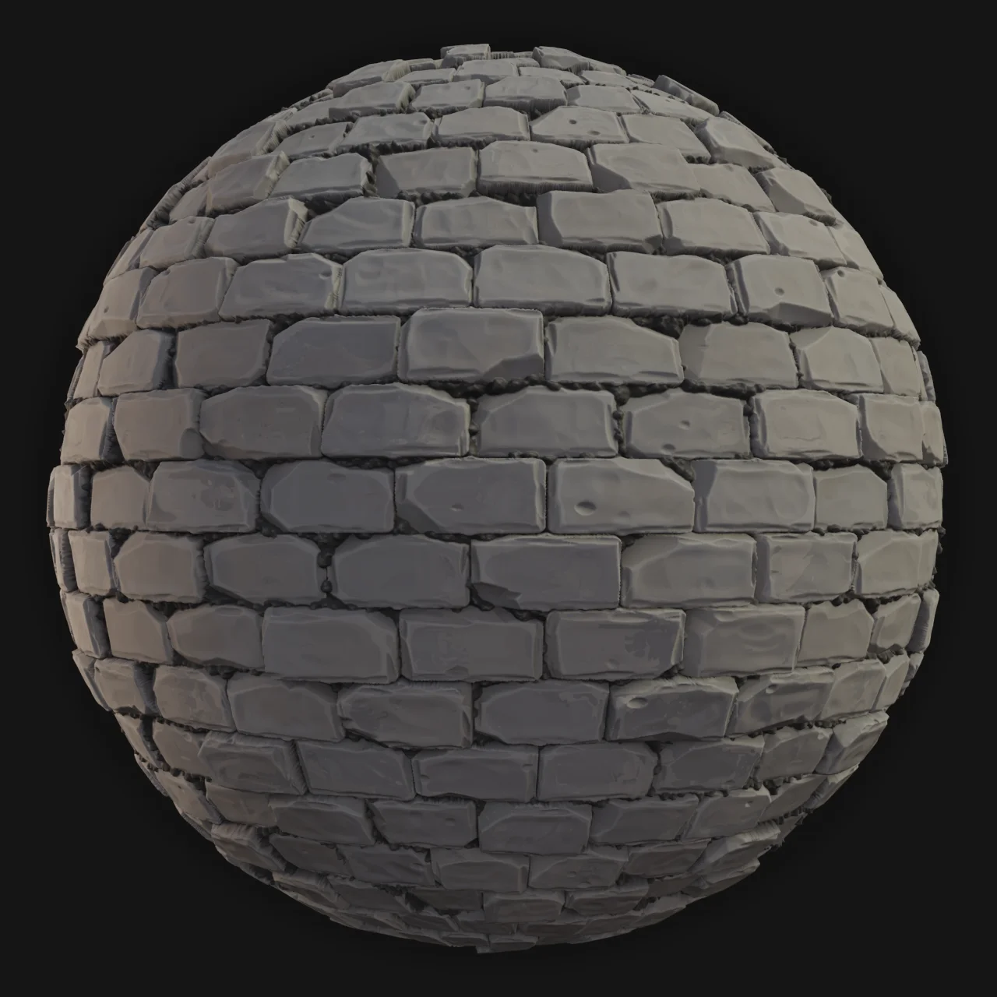
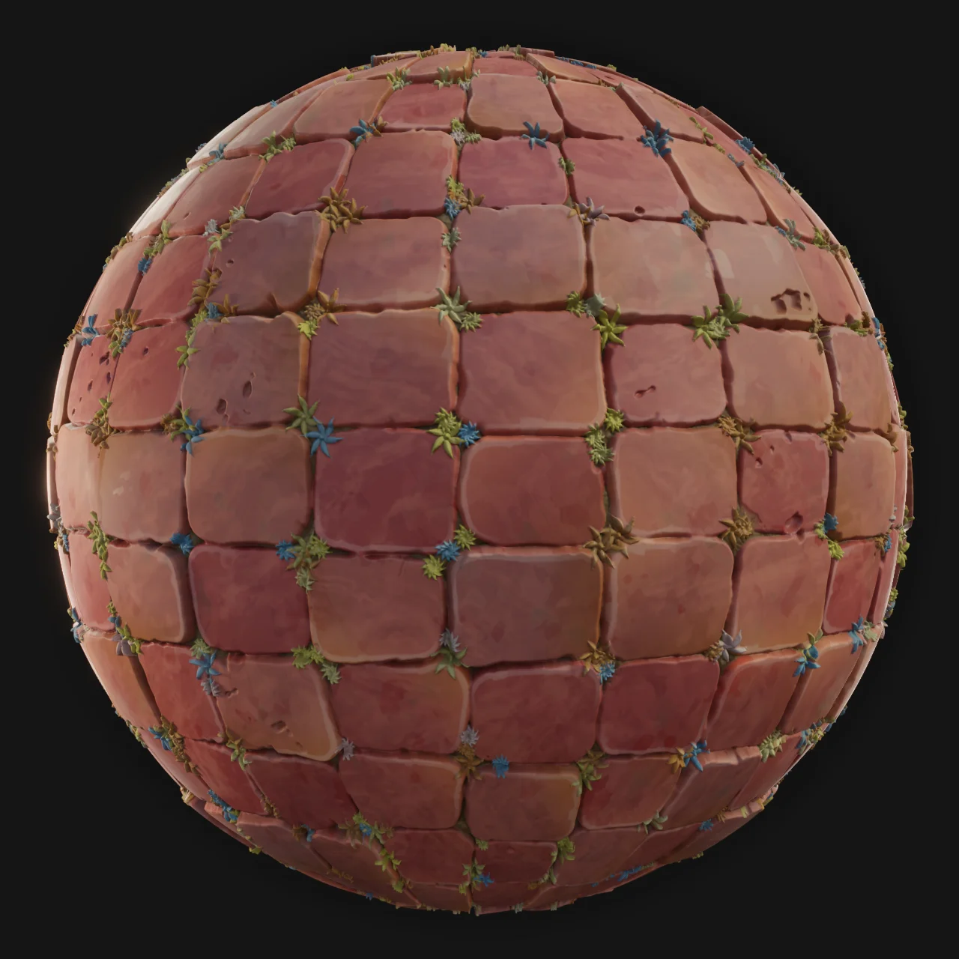

Textures
Textures will further help sell the style of the game.
The use of a hand-painterly style, with exaggerated proportions and features allows for more creative expression.
This also contributes to the light-hearted feel, we want for the game.
Notes:
WIKHO:
We also want to make use of stylistic look.

Slide 14
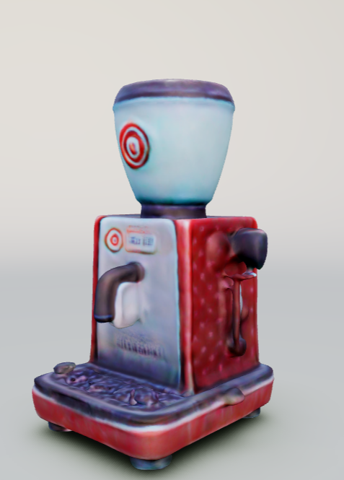
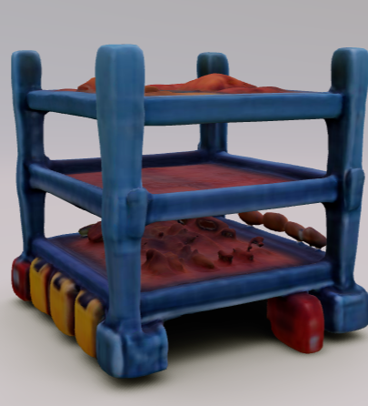
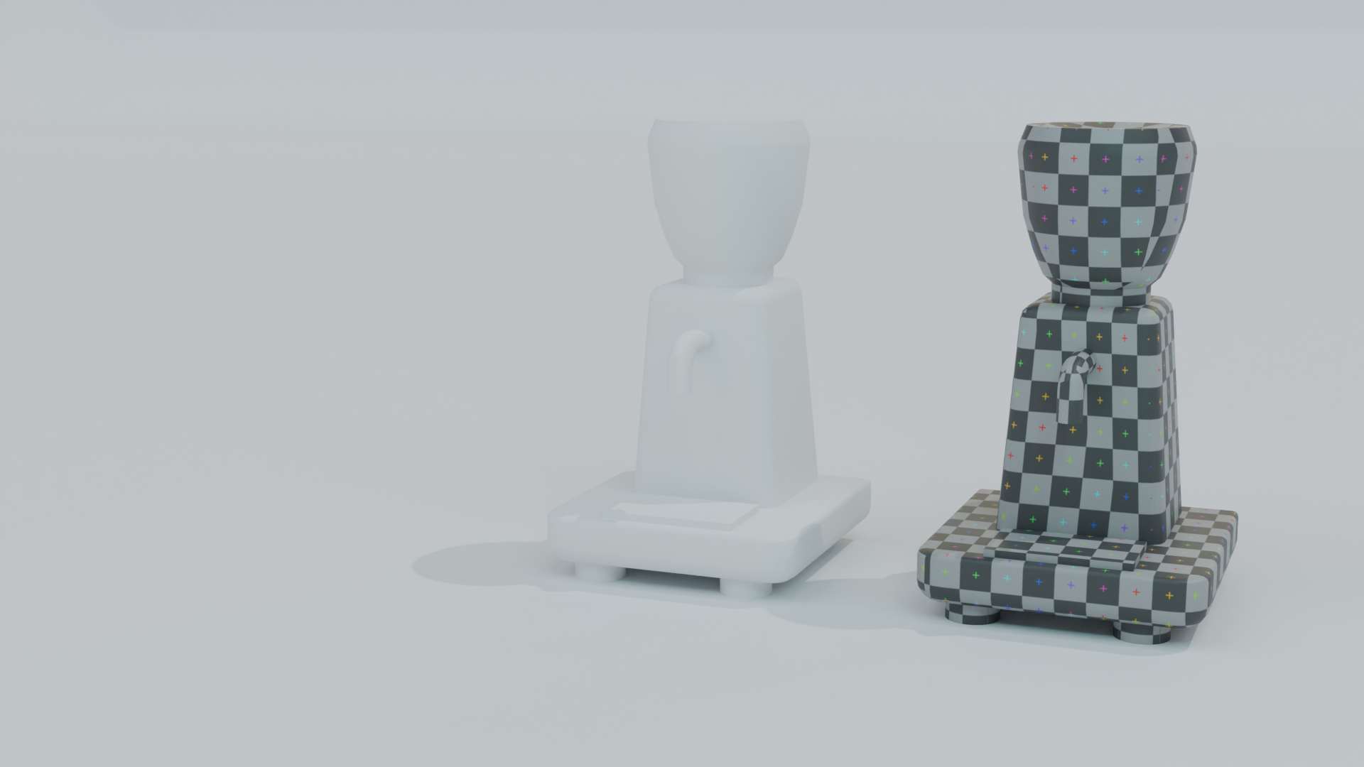
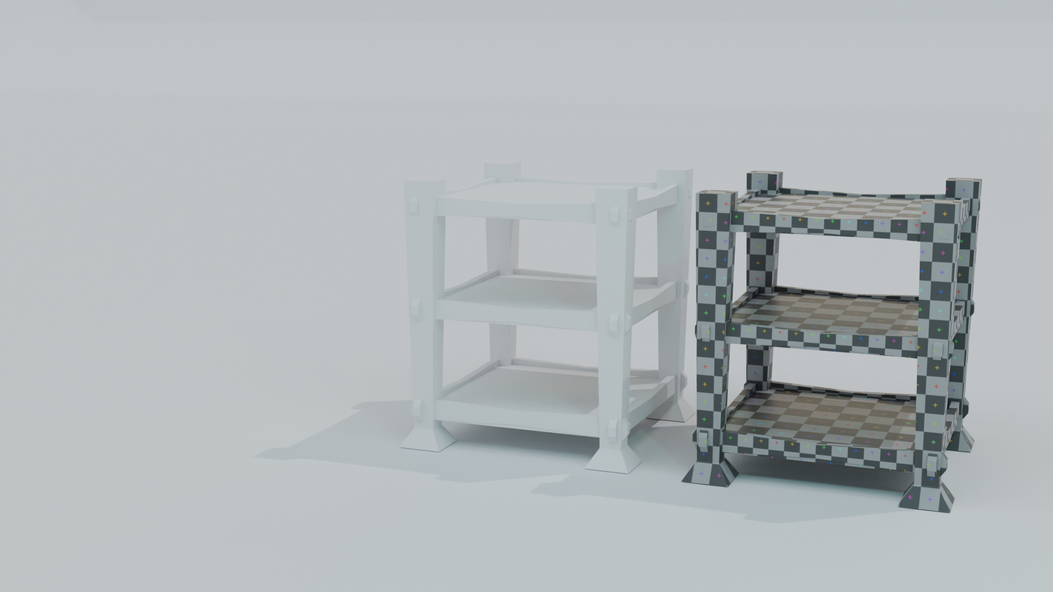
Prop Design
The use of a Stylized theme, is used to make the underlying topic more APPROACHABLE and FUN.
The style helps players feel happy and relaxed, even when facing challenges.

Slide 15



Prop design
Our creative, stylized look makes everything in the game fit together, creating a unique world.
This approach makes players feel more connected to their restaurant, enhancing the overall game experience and making the learning part of the actual situation more likely.

Slide 16
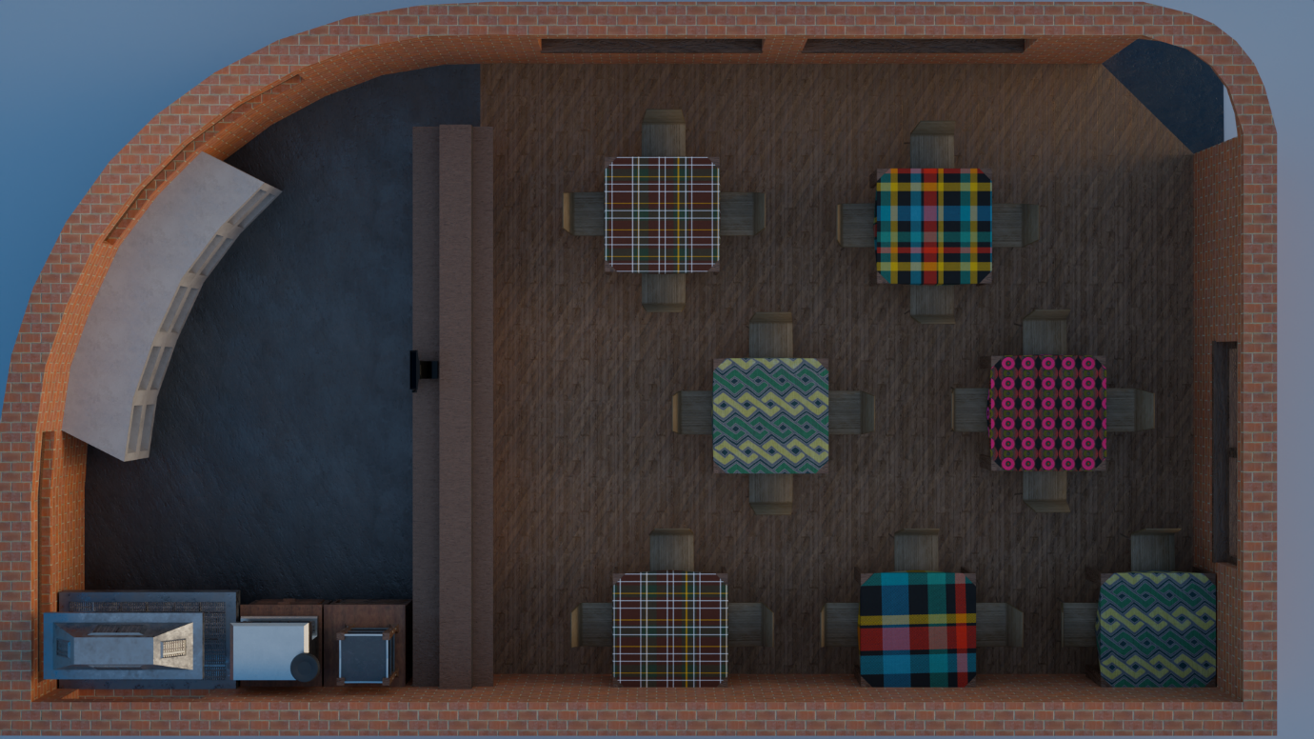
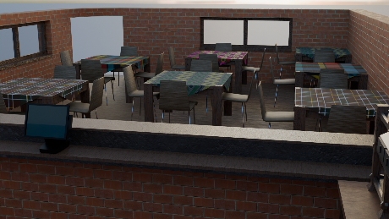
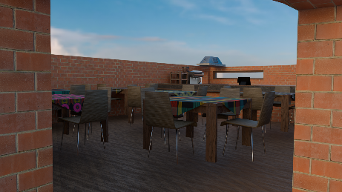
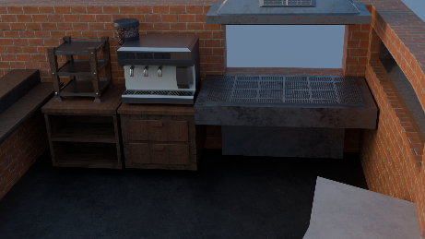
LEVEL DESIGN
Basic Layout of the Café.

Slide 17
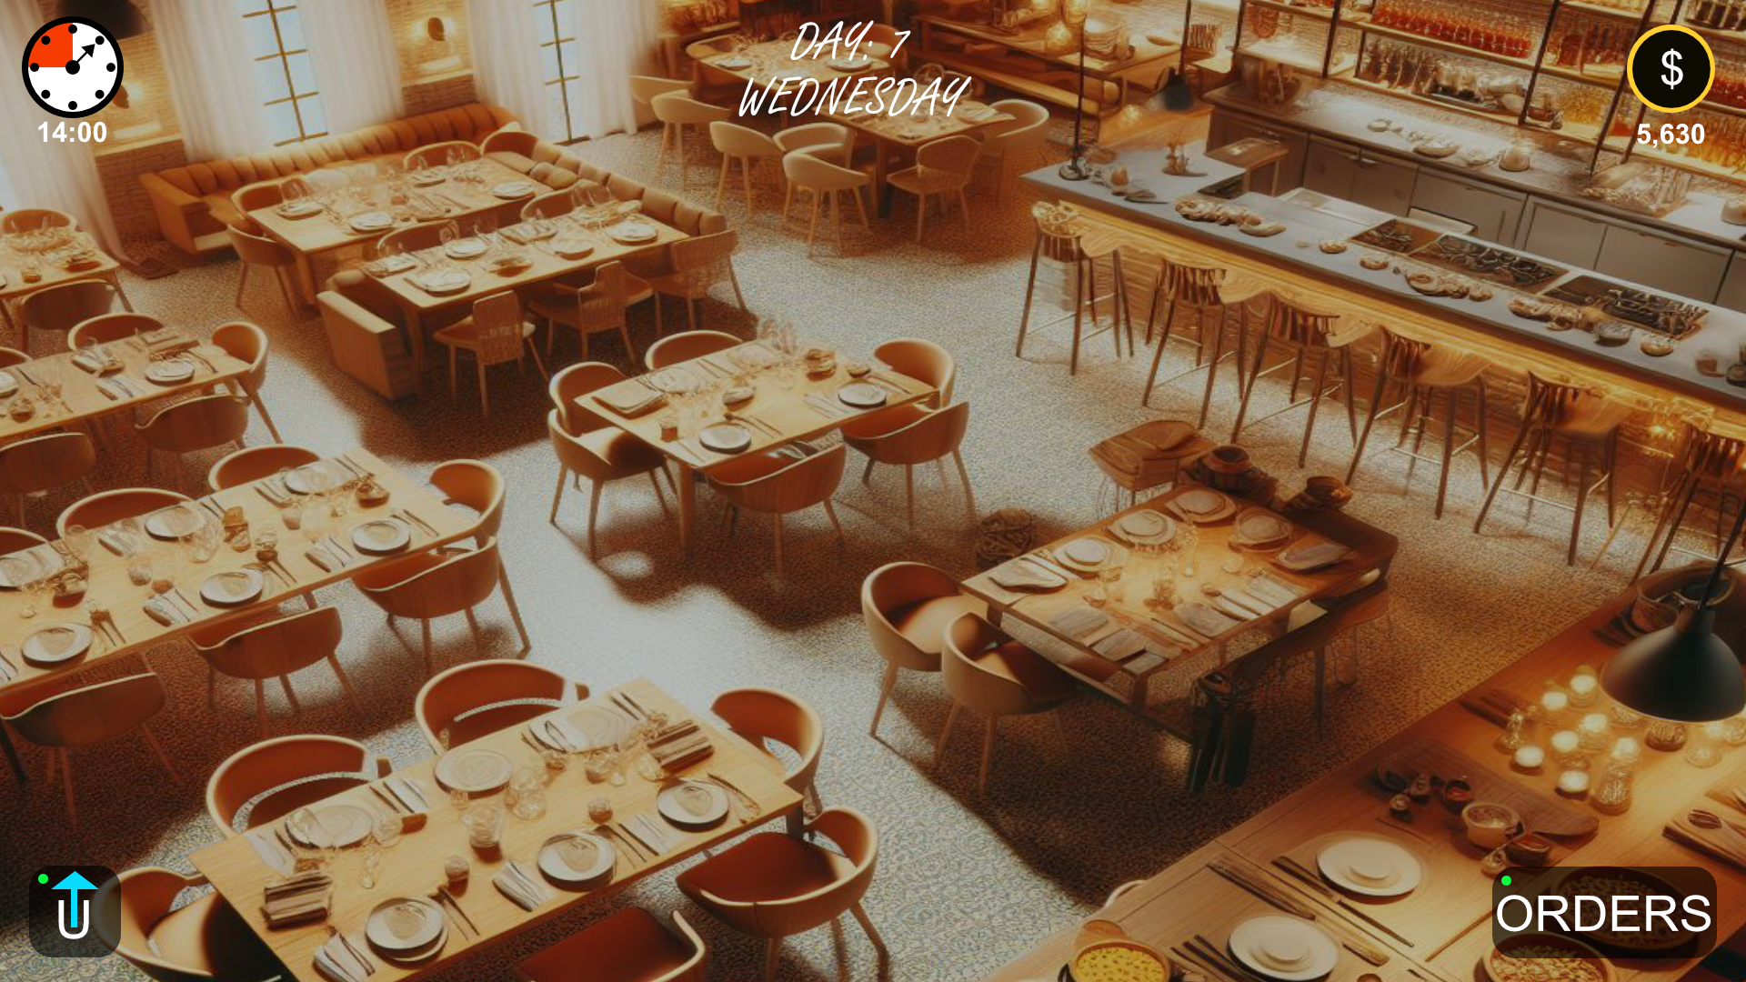
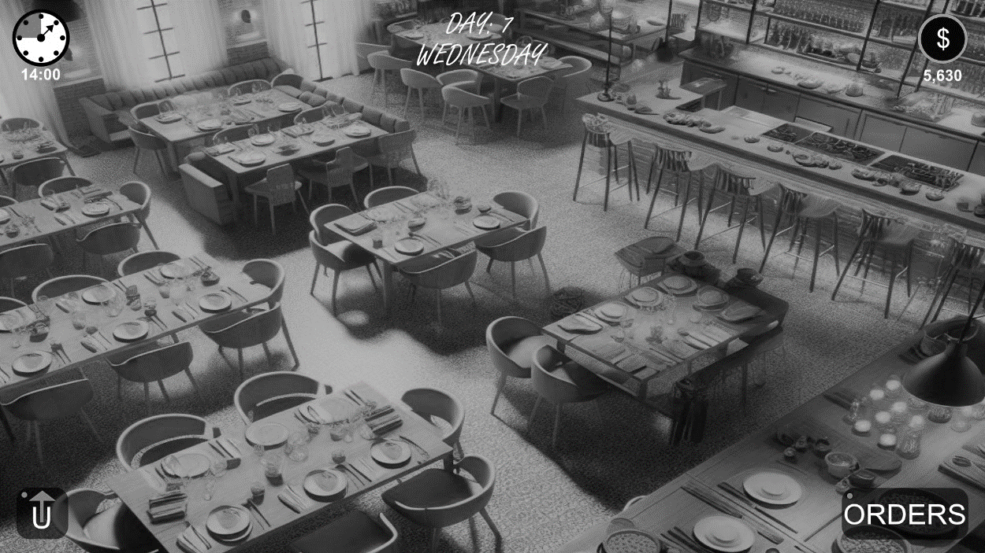
Game UI
HEADS UP Display (HUD)
1
2
3
Day Timer: This timer indicates the current time of day and is also a visual indicator of how much time is left for that level.
Current Day Indicator: This indicates the current day (level) the player is currently on. Day of the week is purely aesthetic.
Money Counter: Shows the current amount of money the player has.
Orders Prompt: When opened, displays current progress of orders players have placed (with the kitchen).
Upgrades Prompt: When players are near the upgrade station, this will pop-up to show that they are able to purchase upgrades.
4
5
Notes:
DYLAN: We will now look at some of the game UI.

Slide 18
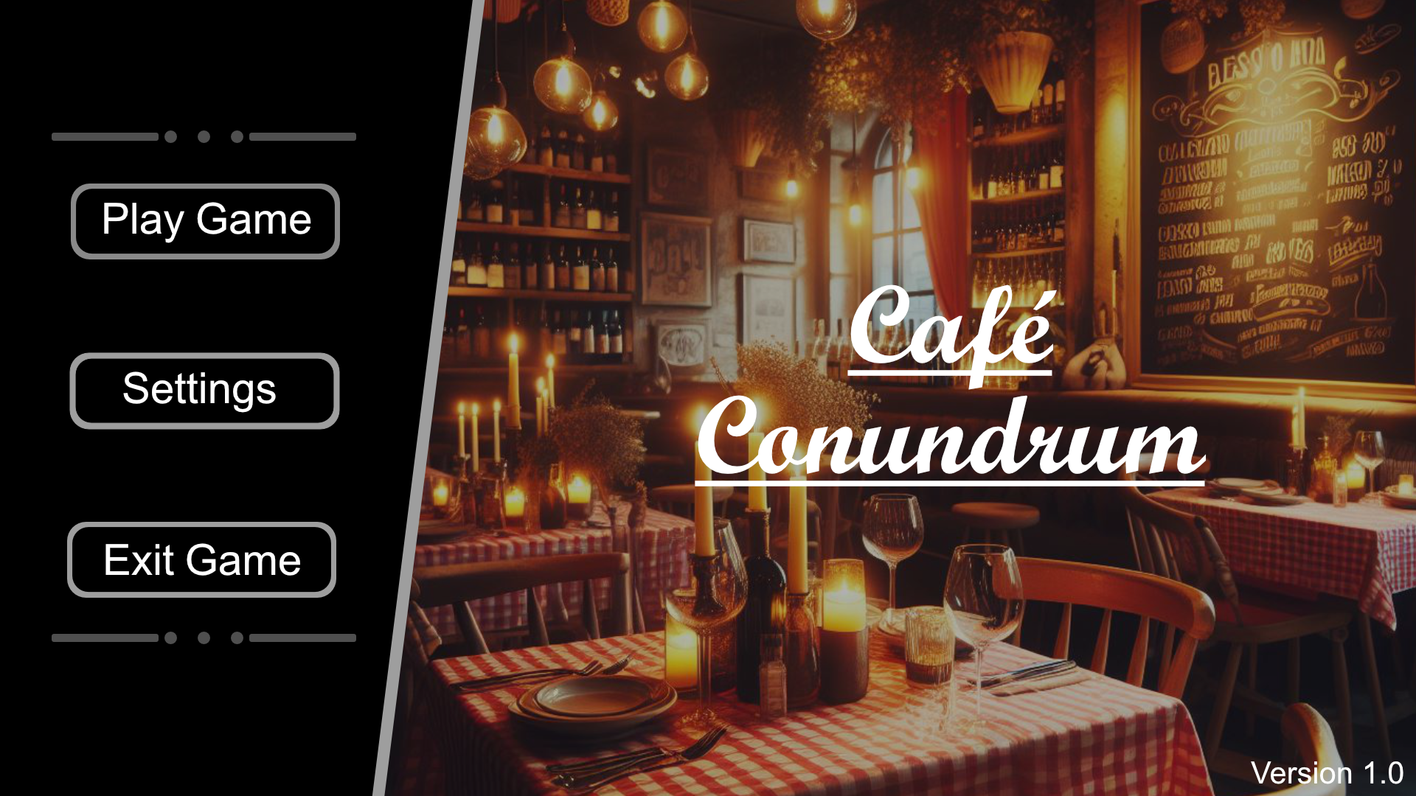

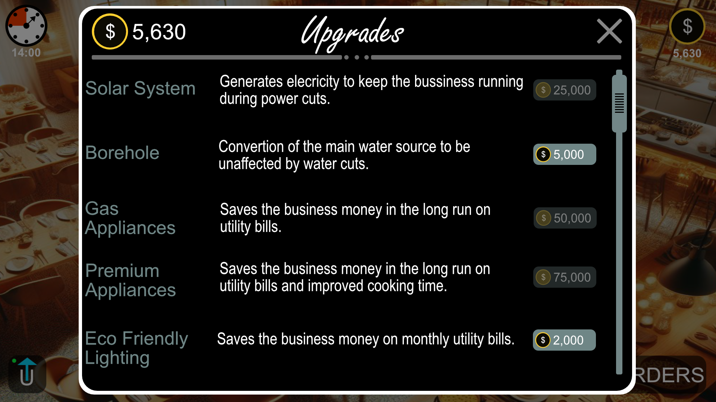
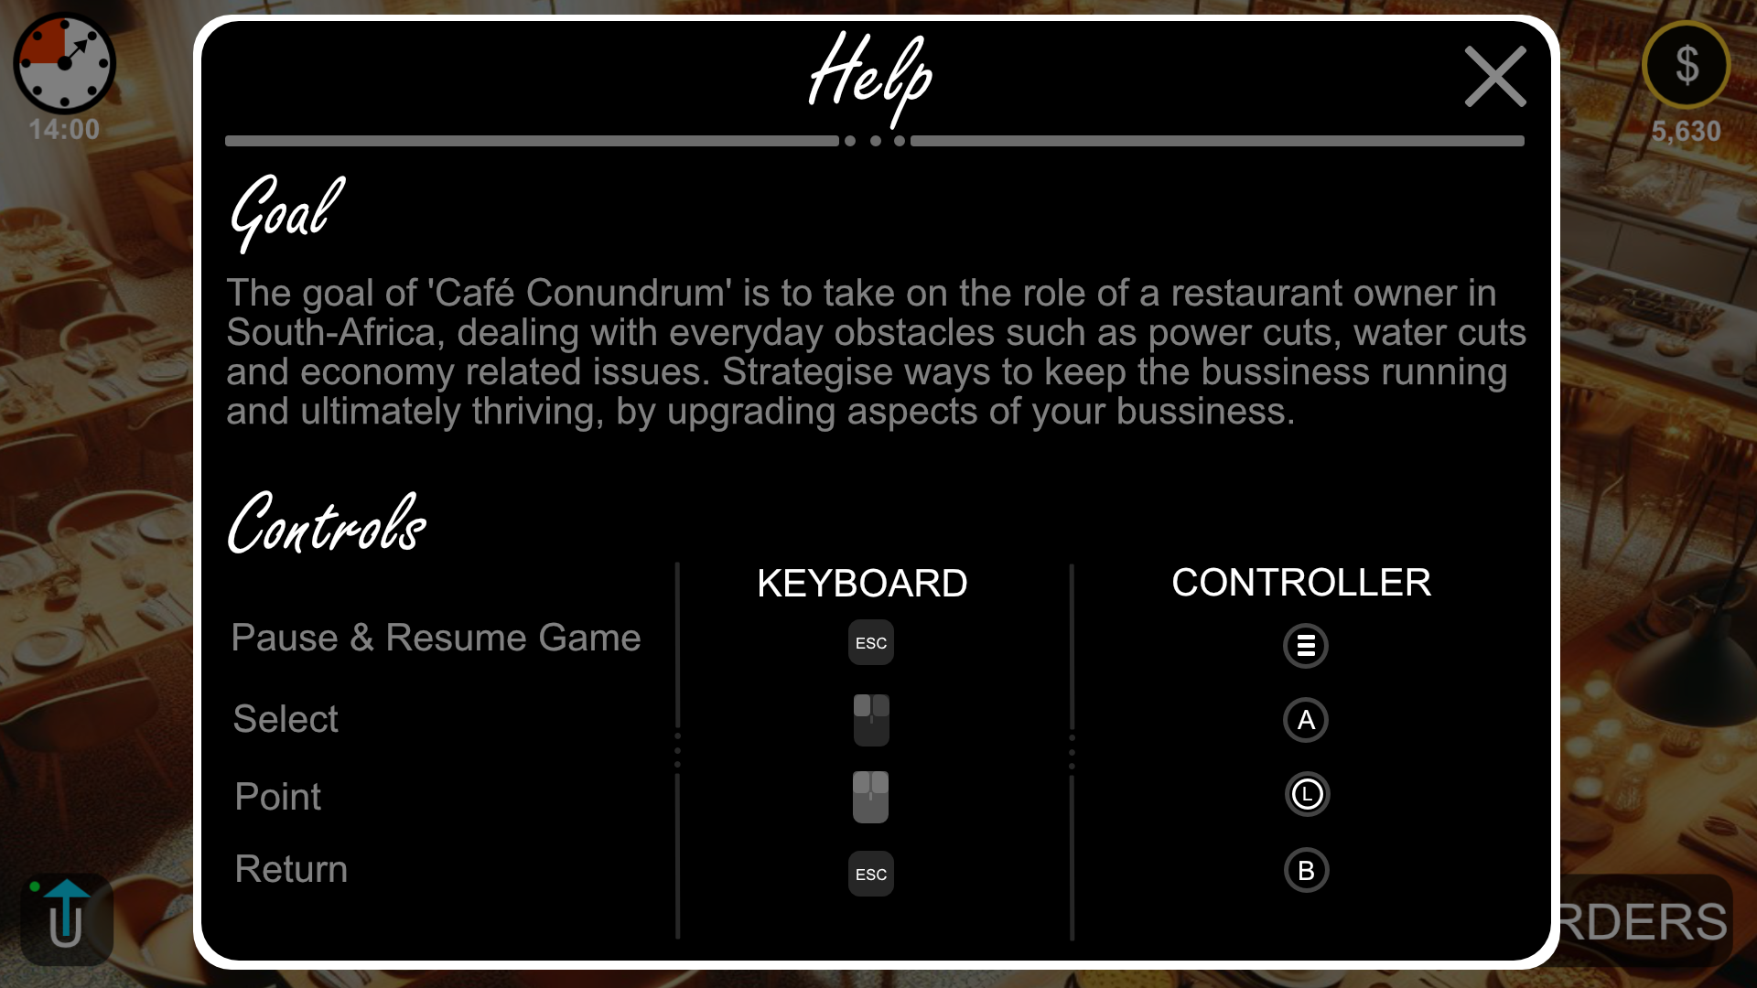
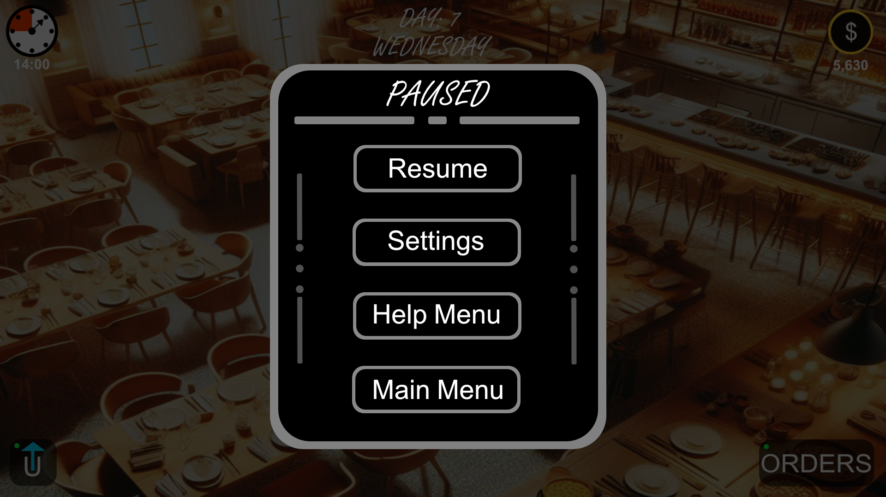
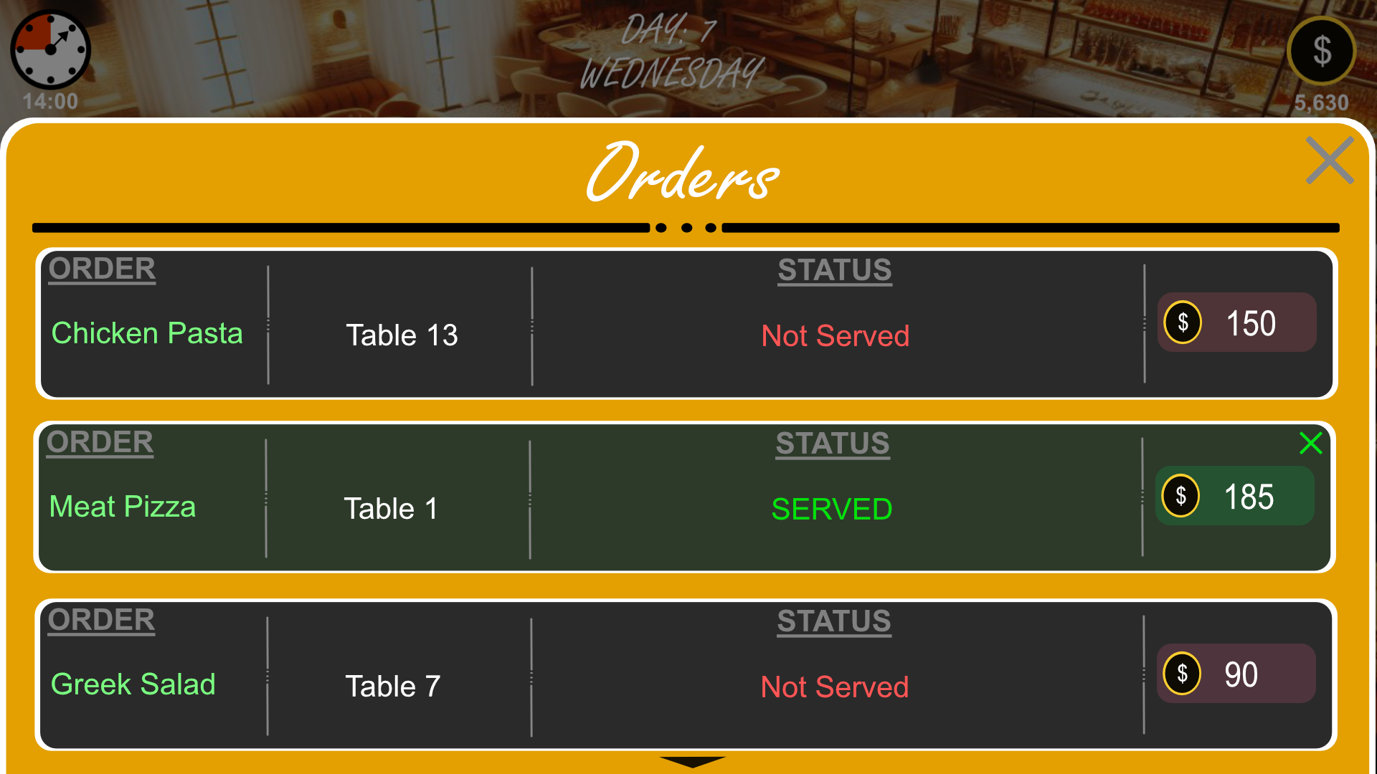
Game UI
Additional UI Scenes
Simplicity, to contrast the game’s possible chaos.

Slide 19
- END – Thank You

